Slide 1

Physics teaching and the IT revolution
John Nunn
National Physical Laboratory, UK

Slide 2
Effect of computers on life in general
How you write letters
How you read letters
How you listen to music
How you compose music
How you take photographs
How you telephone
How you read maps
How products are designed
How products are made
How you shop
How you pay
How you are paid
How your electricity is metered
How you read/watch the news
How your doctor diagnoses you
How the surgeon operates on you!
…

Slide 3
Effect of Computers at School?
Preparation of time tables
Attendance register
Communication with parents
School accounts
Word processing / spreadsheets
Spell checking
Literature Research (Google, Wikkipedia)
Plagiarism (cut and paste)
Distractions (facebook, Youtube…)

Slide 4
Effect on various subjects
Music – recording, editing, mixing
Photography – reduction in cost, image editing and processing
Biology – microscopy, video recording (time compression)
Chemistry – Molecular visualisation, rate calculations
History – Documentaries, news recordings
Geography – Google Earth, Nasa Websites
…
Physics

Slide 5
The teaching physics should prepare students for the way in which physics is done today!
Many experiment designs are modelled beforehand
Many experimental results are modelled for greater understanding
~ 99% of data is recorded by computers
~ 85% of experiments are controlled by computers
~ 99.9% of data is analysed on computers
~ 95% of publishable research is presented on computers (powerpoint, pressi, etc)
100% of scientific papers are word-processed

Slide 6
Additional Benefits of IT in Physics
Eliminate human error
Remove human interference (humidity, temperature, vibration)
Much more data (weeks, months, years of observations)
Faster data (Mhz is very affordable)
Removes the “Donkey Work”
Frees the physicist to concentrate on interpretation/understanding
Testing hypothesis via modelling

Slide 7
Two very different Benefits
Controlling/monitoring real experiments
(control and data-logging)
Interactive Simulations
(Observation and “what if”)

Slide 8
Advantages of Simulations
Simulations help teaching and help understanding
Simulations can be duplicated to match the number of students
Simulations are not dangerous or fragile
Simulations help visualisation
Simulations enable students to learn at different speeds
Simulations exploit student’s natural curiosity
Simulations are fun (better than teacher talking!)

Slide 9
Objections?
Affecting Teachers
Time consuming
Expensive
Distracting
I already have prepared lesson plans
Software Packages are too “restrictive” or “controlling”
More work for the teacher!
Need internet connection
I don’t understand computers!
Affecting Pupils
‘Hands-on’ laboratory skills
Learn to read and record data
Passive (sit and watch)
Lazy

Slide 10
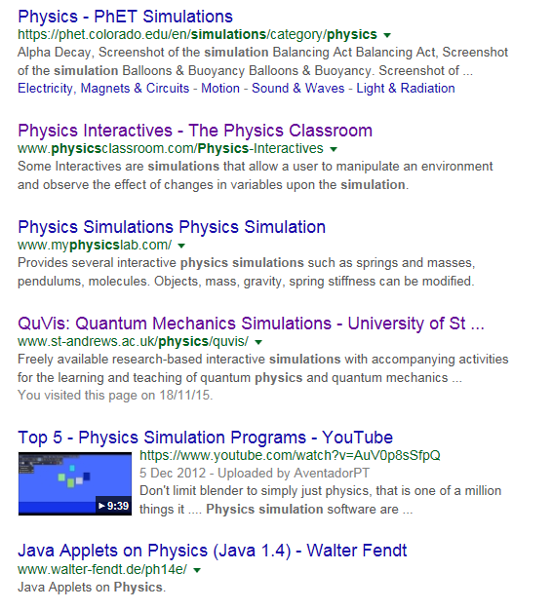
Resources:
Some are ready made
Some are to make simulations
Some need the internet
Some take you “guided tour”
Some are ‘click and watch’ (not truly interactive)
Some are one cost only
Some are annual subscriptions

Slide 11
www.vplab.co.uk
300+ simulations and interactive experiments
Curriculum independent
Low IT requirements
Written by a physics teacher (not a commercial company!)
Intuitive operation
Truly interactive
Low cost (once only) – 70 Euros for a Teacher License

